Slide 1

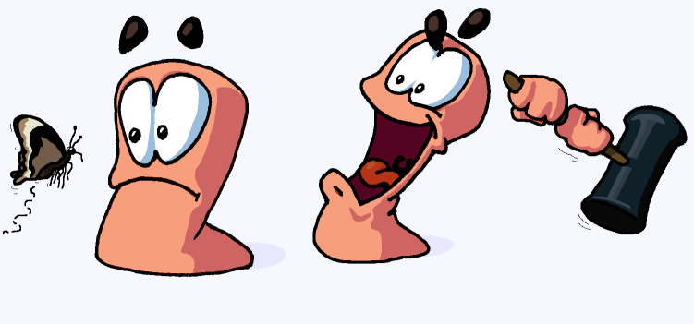
Team 4
Squires: Knights in the Making
By:
Alex Ogilbee
Joseph Hill
Fernando Trevino

Slide 2
First Playable
Commitment
Progress
Map generation
Framework of terrain in place
No environment hazards
Core Weapons Implemented
Missile, Rifle, Grenade, Melee
AI can move and shoot
Working Game State
Match will play from start to finish
Rudimentary Weapon Swap
Destructible Terrain
Map generation
Framework of terrain in place
Core Weapons Implemented
Homing Missile, Bazooka, Sniper
AI targeting
Working Game State
Match will play from start to finish
Rudimentary Weapon Swap
Destructible Terrain
Pre-Game menu
Game clocks

Slide 3
Task Breakdown
Alex
Pre Game Menu
Game clocks
Weapon Implementation
Menu art
Joseph
WordPress updates
Map Generation
AI targeting
Audio Management
Environment art
Fernando
Player Movement/Controls
Camera Controls
Health system
Weapon Implementation
Player animations

Slide 4
Challenges
Git Version control and merge conflicts with Unity settings
Finding free art that matched art style
Generating a playable map
Physics and animations integration

Slide 5
Demo

Slide 6
Commitments for Testing Day 11/18
3 Map themes
Improve map generation
Weapon inventory per team
Environment graphics polishing
More weapons
Sounds
Background Music for each map theme
Weapons
Player death
Pause Menu
In-Game UI
Weapons
Player Name and health bar
Options Menu
Supply drops
Improved AI Player shooting and movement
Scalable UI

